Slide 1
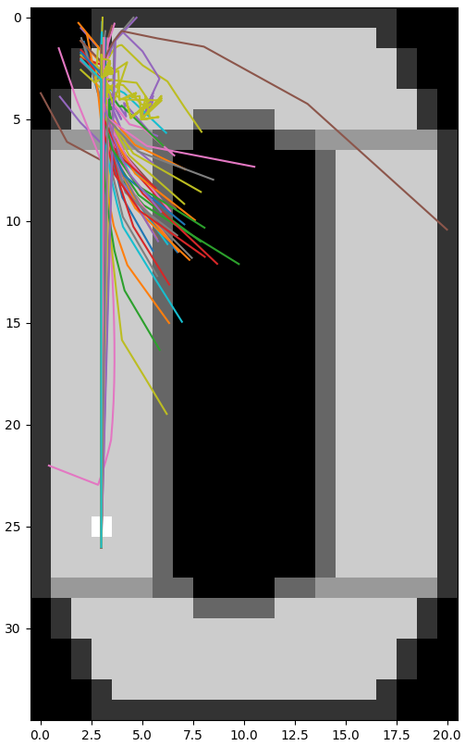
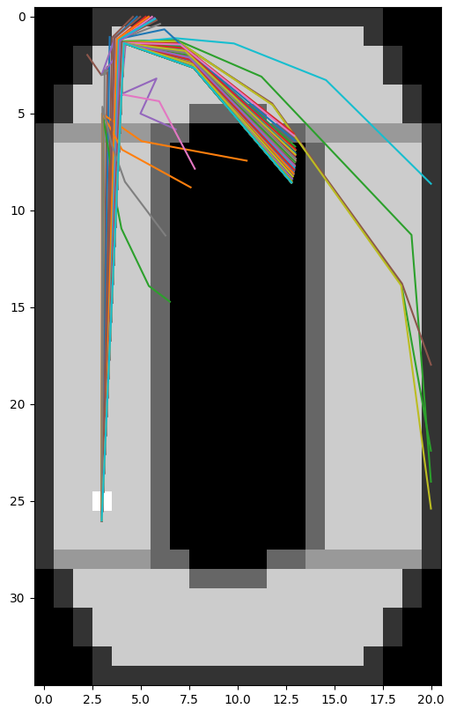
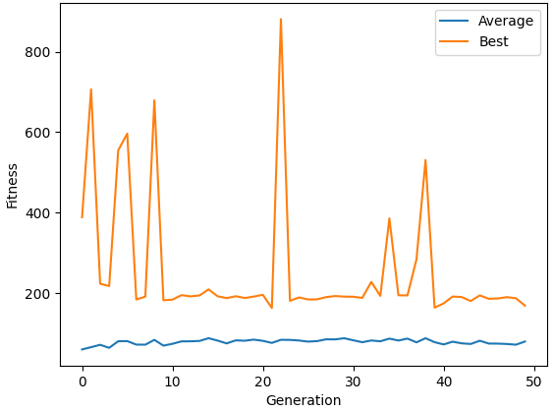
HOOP: Racing Evolved
Gaddiel Morales
Research Question:
How can evolutionary algorithms be used to create a self driving car?
Sensing and Reacting
Cars have 4 sensors in this simulation: distance to left wall, distance to right wall, distance to the front wall, and the car’s current speed. The car may react by changing its speed or turn angle. Since there are 4 inputs and two outputs, the vector of real numbers connecting these values is a length of 8.
Acceleration Trade Off
Initially hypothesized that low acceleration would keep speeds low, but cars would increase acceleration as much as possible on straight portions of the map and drive straight into walls.
Higher acceleration values allow the car to speed up and brake quickly.
However, if the acceleration was too high, cars would also had a tendency to overcompensate.
Results
Exploits found
Diagonal movement
No cars completed the track
Challenges
Overcompensating on turns
Conclusion
There is potential for better performance after more generations since some cars did make it to the second turn
Simulator should penalize going in reverse while still pointed forward.
Very High Acceleration Test
Fitness over time
Moderate Acceleration Test
First generation compared to 100th generation
Hyperparameters:
Max Acceleration: Varied
Max Turn Angle: 35 degrees
Population Size: 100
Mutation Probability: 30%
Crossover Probability: 30%
Tournament Size: 5
Max simulation time: 500 steps
Methodology
This project aims to represent a human driver in control of a car. The car objects are created using a vector of real numbers. These values map the response of a given sensor to a corresponding change in both turn angle and acceleration. Each unit of distance awards the car a point. Checkpoints, which are the gray lines, give 30 points after they are passed. Cars that move in a negative direction to the track are deducted 30 points for each unit moved.

